Slide 1

Kubernetes Installation

Slide 2
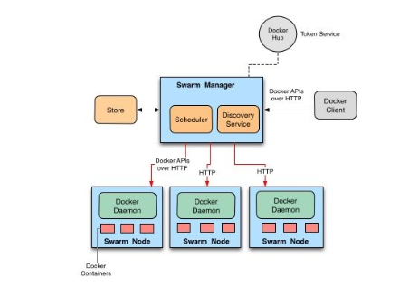
Docker Swarm Architecture

Slide 3
Kubernetes
K8s
System for automating application deployment

Slide 4
Features of Kubernetes
Automated scheduling
Self-healing capabilities
Automated rollbacks and rollouts
Horizontal scaling and load balancing

Slide 5
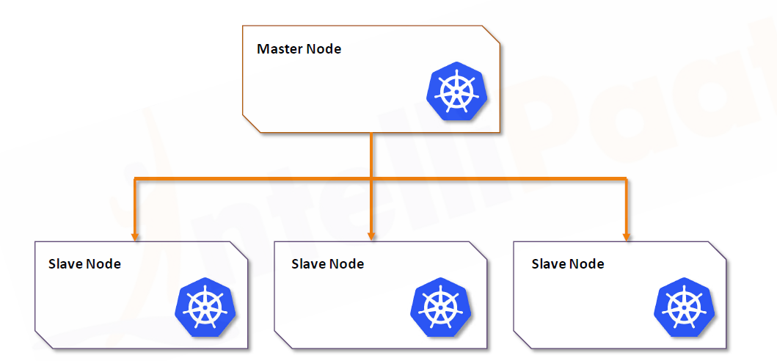
Kubernetes Architecture

Slide 6
In Kubernetes, various subcomponents can be grouped into two main components. The main components are:
Master node
Worker node

Slide 7
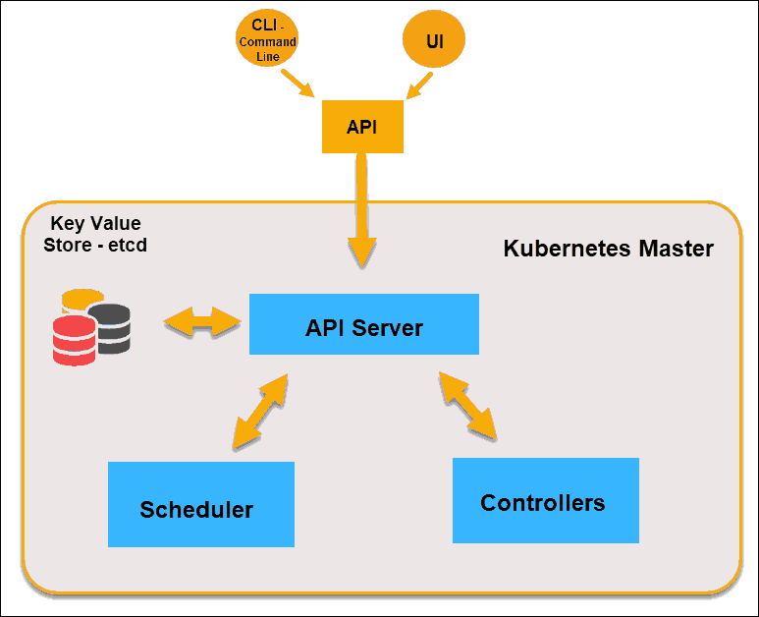
Master Node

Slide 8
As shown in the diagram, the master node comprises different components such as Controller-manager, ETCD, Scheduler, and API Server.

Slide 9
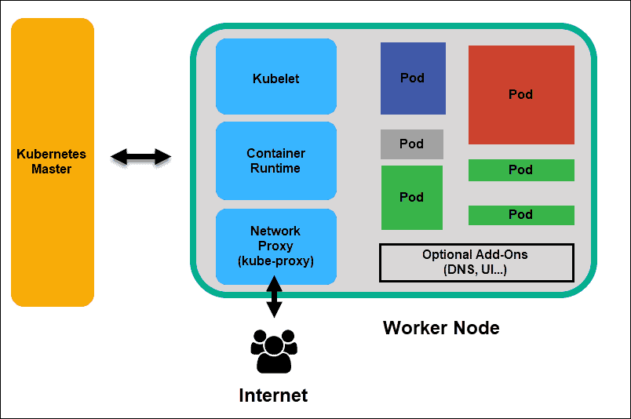
Slave Node

Slide 10
As shown in the architecture diagram above, the worker node has the following components:
Docker container
Kubelet
Kuber-proxy
Pods

Slide 11
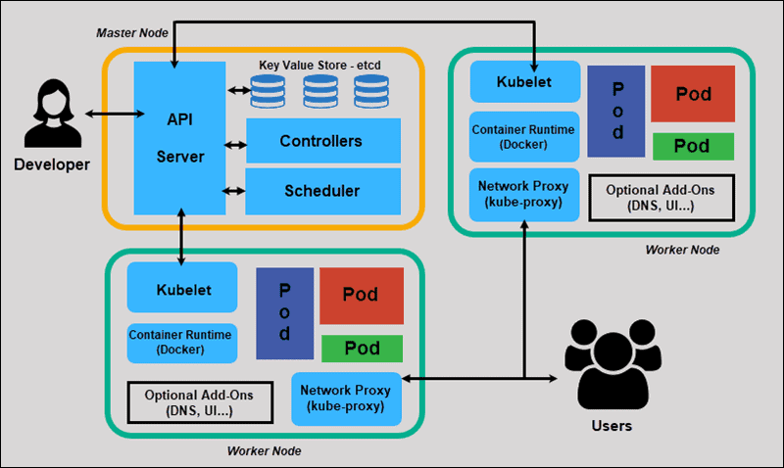
Complete Architecture

Slide 12
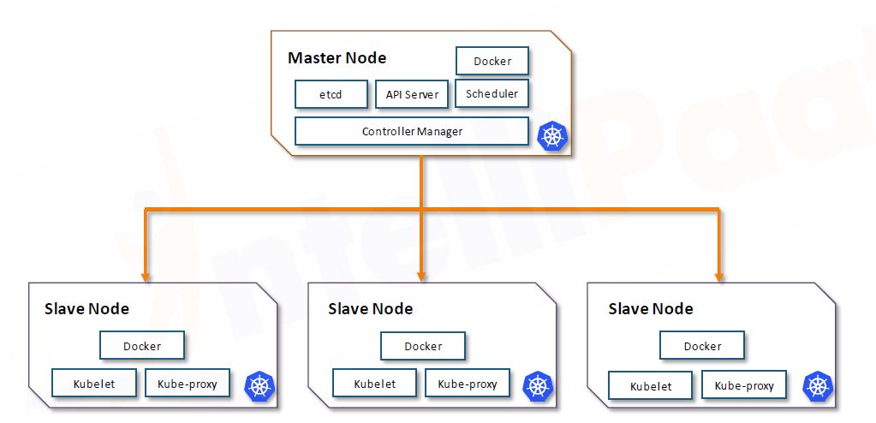
Summary

Slide 13
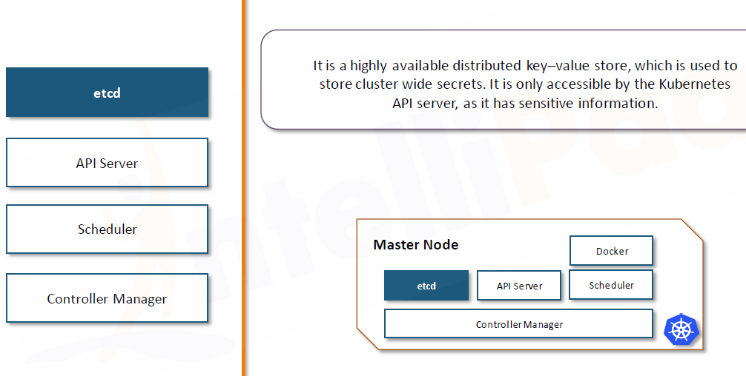
Master components

Slide 14
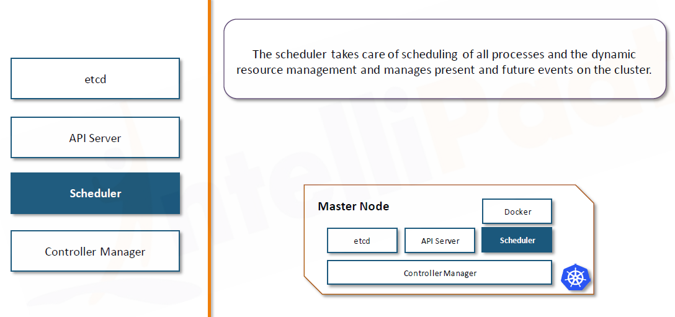
Master components

Slide 15
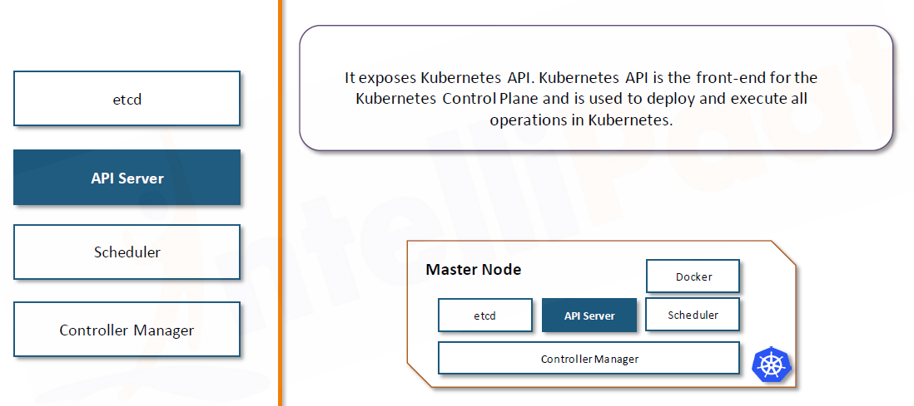
Master components

Slide 16
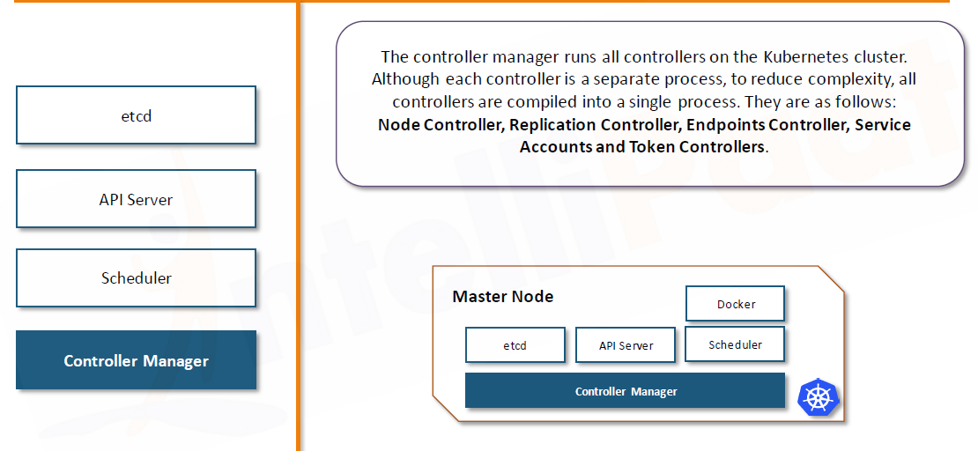
Master components

Slide 17
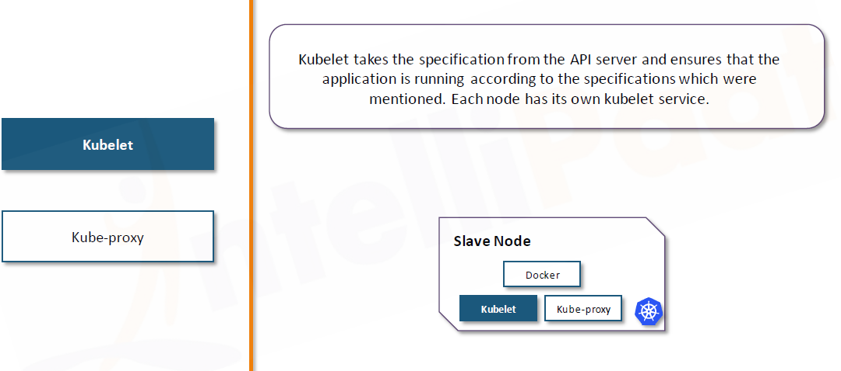
Slave components

Slide 18
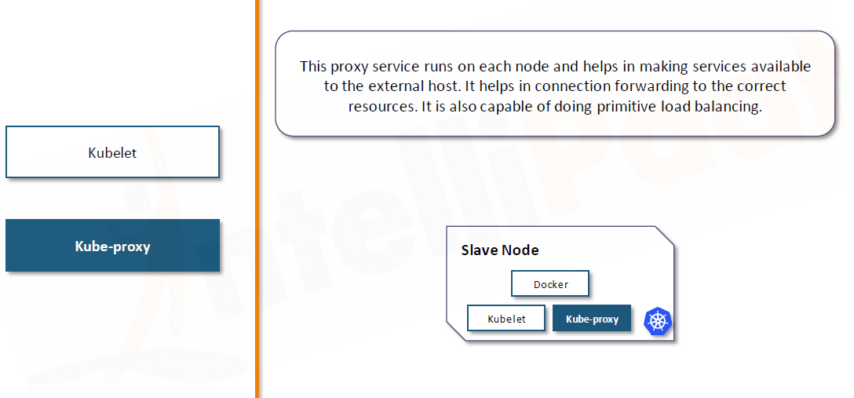
Slave component

Slide 19
What is a Pod?
A pod is the smallest and the most elementary execution unit of Kubernetes.
Pods are also the simplest unit in the Kubernetes object model, which you can create and deploy.
Pods represent the processes that are running on the cluster.
Every pod has different phases that define where it lies in its life cycle. This phase of a pod is not actually a comprehensive roll up of the pod’s state or containers. The phase is just meant to depict the condition of the pod in the current timestamp.

Slide 20
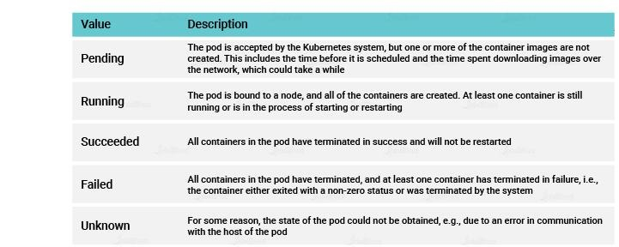

Slide 21
Installing Kubernetes
Steps for Both Master and Slave
Step 1: Run the following commands for installing kubeadm as root:
$ apt-get update
$ apt-get install docker.io
$ apt-get update && apt-get install -y apt-transport-https curl
$ curl -s https://packages.cloud.google.com/apt/doc/apt-key.gpg | apt-key add -
$ cat <<EOF >/etc/apt/sources.list.d/kubernetes.list
deb https://apt.kubernetes.io/ kubernetes-xenial main
EOF
$ apt-get update
$ apt-get install -y kubelet kubeadm kubectl

Slide 22
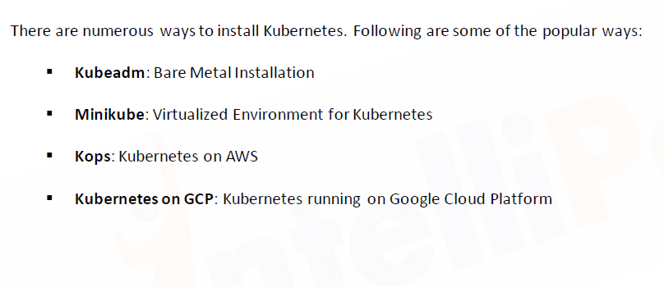
Kubernetes Installation

Slide 23
Steps for Kubernetes Master
Step 1: Initialize kubeadm using the following command:
$ kubeadm init --apiserver-advertise-address= <ip-address-of-master> --pod-network-cidr=192.168.0.0/16 --ignore-preflight-errors=all

Slide 24
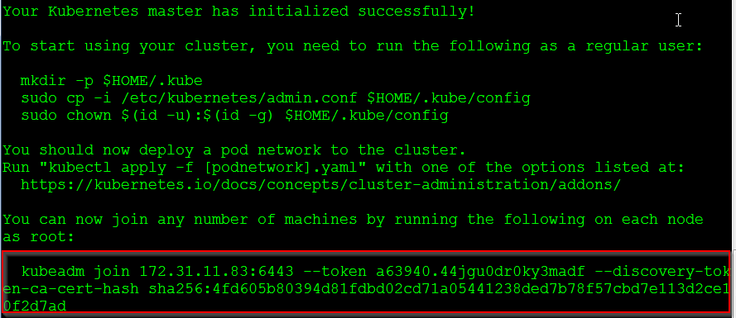
Step 2: In the output of the previous command, you will get a command, take this command and run it in the slave

Slide 25
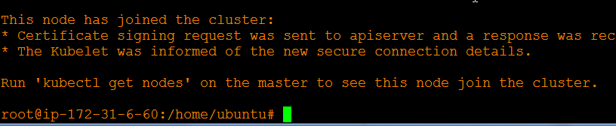
After running the previous highlighted command on slave, you will get the following output:

Slide 26
Step 3: On the master, exit to the normal user, and execute the following commands:
$ mkdir -p $HOME/.kube
$ sudo cp -i /etc/kubernetes/admin.conf $HOME/.kube/config
$ sudo chown $(id -u):$(id -g) $HOME/.kube/config

Slide 27
Step 4: Next, let’s install the network plugin. Execute the following commands:
kubectl apply -f "https://cloud.weave.works/k8s/net?k8s-version=$(kubectl version | base64 | tr -d '\n')"
$ kubectl apply -f https://docs.projectcalico.org/v3.3/getting-started/kubernetes/installation/hosted/rbac-kdd.yaml
$ kubectl apply -f https://docs.projectcalico.org/v3.3/getting-started/kubernetes/installation/hosted/kubernetes-datastore/calico-networking/1.7/calico.yaml

Slide 28
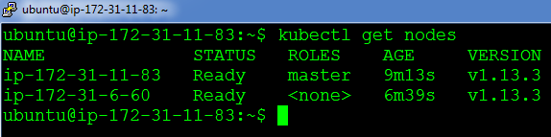
Step 5: The previous command will take some time to take effect. After 4-5 mins, try the following command, if both the nodes are in the ready state, Installation is successful!
$ kubectl get nodes

